Slide 1
Learning Outcomes
After successful completion of this chapter, students are expected to:
  Define what motivation is
  Identify the two types of motivation
  Compare the different theories of motivation
  Explain the different types of conflicts of motives
  Define what emotion is
  Discuss the three elements of emotion
  Discuss the different theories of emotion

Slide 2
5.1.1. Definition and types of motivation
Motivation is a factor by which activities are started, directed and continued so that physical or psychological needs or wants are met.
Motivation is the dynamics of behavior or a force that initiates, energizes, directs and sustains activities of a person toward a goal
  The word itself comes from the Latin word ‘Movere‘, which means ―to move.
  Motivation is what moves people to do the things they do.
There are different types of motivation. But, it is possible to categorize them into two:-
  Intrinsic motivation -is a type of motivation in which a person acts because the act itself is rewarding or satisfying in some internal manner.
  Extrinsic motivation -is a type of motivation in which individuals act because the action leads to an outcome that is external to a person

Slide 3
Meaning and Concepts (contd)
Motivation is a cycle of three stages:
1. a motivating state within the organisms, it has various names; needs and drives.
Needs are specific states with the organism which is based on some deficit and that may elicit behavior.
Drives are internal states with the organism which pushes the organism into action towards a particular goal
Incentives are external motivating stimulus such as money, praise, fame or attention
2. Behavior aroused & directed by the first state, the behavior that is activated by the motive, and
3. An intended goal toward which the behavior is directed -
the reduction or satisfaction of the motives which is ordinarily achieved by reaching some goal
E. W/G
September, 2008

Slide 4
Meaning and Concepts (contd)
A model of motivation
Need Drive Response Goal
(Need reduction)
Types of Motives
A. Primary and Secondary Motives
Primary Motives
Secondary Motives
E. W/G
September, 2008

Slide 5

Instinct approaches to motivation - Born to Be Motivated -
  people are motivated to engage in certain behaviors because of evolutionary programming
  motivation is the result of biological or genetic program
    Just as animals are governed by their instincts to do things such as migrating, nest building, mating and protecting their territory, human beings may also be governed by similar instincts.
      Some instincts in humans including curiosity, flight (running away), pugnacity (aggressiveness), and acquisition (gathering possessions).

Slide 6

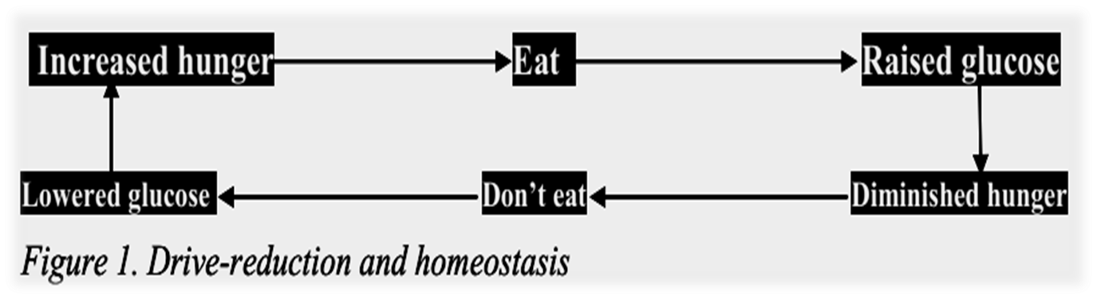
b) Drive reduction theory - Satisfying our Needs
  Behavior is motivated by the desire to reduce internal tension caused by unmet biological needs, such as hunger or thirst.
  Motivation is driven by internal biological needs, i.e. drives
    Drives are of two kinds; primary and secondary.
  Drive: is a motivational tension that energizes behavior in order to fulfill some end, the restoration of homeostasis - drive-reduction theory does not explain all human motivation. People do not always seek to reduce their inner arousal

Slide 7

c) Arousal approaches: beyond drive reduction
  Maintaining a certain level of stimulation and activity. The aim of motivation is to maintain an optimal level of arousal that is pleasurable
  Arousal approaches seek to explain behavior in which the goal is to maintain or increase excitement.
d) Incentive approaches: motivation’s pull
  Motivation stems from the desire to attain external rewards, known as incentives.
  In this view, the desirable properties of external: like grades, money, affection, or sex —account for a person‘s motivation.

Slide 8

e) Cognitive Approaches: the thoughts behind motivation
  suggest that motivation is a result of people’s thoughts, beliefs, expectations, and goals.
    For instance, the degree to which people are motivated to study for a test is based on their expectation of how well studying will pay off in terms of a good grade.
  This theory draw a key difference between intrinsic and extrinsic motivation.
    Intrinsic motivation causes us to participate in an activity for our enjoyment rather than for any actual or concrete reward that it will bring us.
    In contrast, extrinsic motivation causes us to do something for money, a grade, or some other actual, concrete reward

Slide 9
f) Humanistic approaches to motivation - Abraham Maslow
  we are driven to achieve our maximum potential and will always do so unless obstacles, such as hunger, thirst, lack of finance or safety, are placed in our ways
  human behavior is influenced by a hierarchy of five classes of needs, or motives.
  Physiological needs- these are biological requirements for human survival, e.g. air, food, drink, shelter, clothing, warmth, sex, sleep.
  Safety needs- protection from elements, security, order, law, stability, freedom from fear.
  Love and belongingness needs- need for friendship, intimacy, receiving and giving affection and love.
  Esteem needs- the need to be respected as a useful, honorable individual
  Self-actualization needs- realizing personal potential, self-fulfillment, seeking personal growth and peak experiences. A desire ―to become everything one is capable of becoming

Slide 10
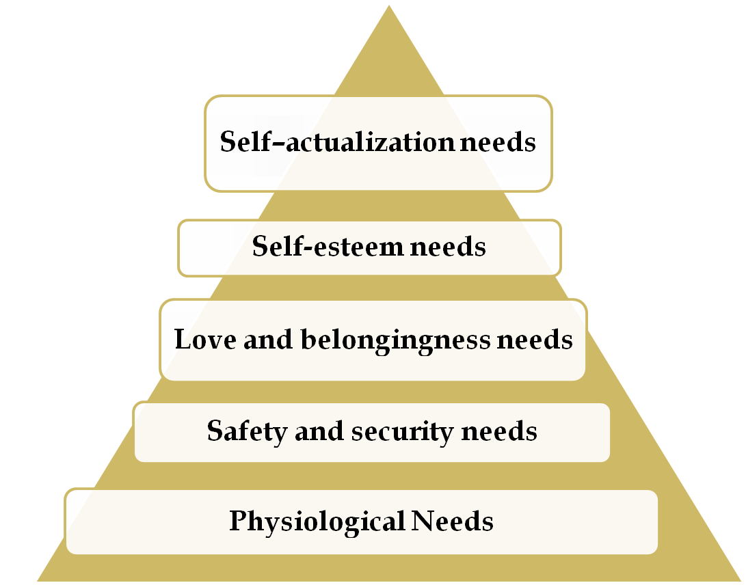
E. W/G
September, 2008
Ordering Motivational Needs

Slide 11

Frustration – is a person’s negative emotion due to actual or imagined
diversion from a goal,
blocking of goal-directed behavior, or
loss of an already achieved goal.
If motives are frustrated or blocked, emotional feelings and behaviors often result.
Sources of frustration
Personal inadequacies (lack, failure, losses, laziness, aloofness)
Environmental (both physical & social environment)
Conflict Induced (conflicts of motives) – incompatible goals

Slide 12

There are four basic types of motivational conflicts.
  Approach-approach conflicts - exist when we must choose only one of the two desirable activities. Example, going to a movie or a concert.
  Avoidance-avoidance conflicts - arise when we must select one of two undesirable alternatives. E.g. Someone forced either to sell the family home or to declare bankruptcy.
  Approach-avoidance conflicts - happen when a particular event or activity has both attractive and unattractive features.
  Multiple approach-avoidance conflicts - exist when two or more alternatives each have both positive and negative features.

Slide 13
5.2.1. Definition of emotion
Emotion can be defined as the ―feeling aspect of
consciousness, characterized by certain physical arousal, certain behavior that reveals the feeling to the outside world, and an inner awareness of feelings.
Emotion is a physical departure from homeostasis that is subjectively experienced in strong feeling like love, hate, desire, or fear and manifests itself in neuromuscular, respiratory, cardiovascular, hormonal and other bodily changes
Thus, from this short definition, we can understand that there are three elements of emotion:
    the physiology,
    behavior and
    subjective experience.

Slide 14
The physiology of emotion - when a person experiences an emotion, there is physical arousal created by the sympathetic nervous system.
  The heart rate increases, breathing becomes more rapid, the pupils of the eye dilate, and the moth may become dry.
The behavior of emotion- tells us how people behave in the grip of an emotion. out-ward or overt manifestation of behaviour by verbal or non-verbal channels
  There are facial expressions, body movements, and actions that indicate to others how a person feels. Frowns, smiles, and sad expressions combine with hand gestures, the turning of one‘s body, and spoken words to produce an understanding of emotion.
Subjective experience or labeling emotion it involves interpreting the subjective feeling by giving it a label: anger, fear, disgust, happiness, sadness, shame, interest, surprise and so on.
beliefs or expectances towards certain things that we feel and label as emotion

Slide 15

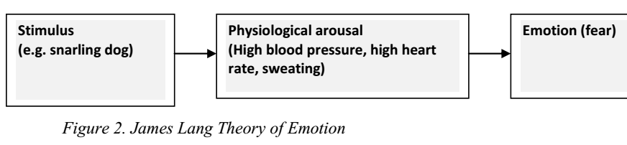
James- Lang Theory of Emotion
  States that emotional experience is reaction to instinctive bodily events that occur as a response to some situation or event in the environment
    James and Lang believed that physical arousal led to the labeling of the emotion (fear).
    Simply put, “I am afraid because I am aroused, or ―I am embarrassed because my face is red” etc

Slide 16

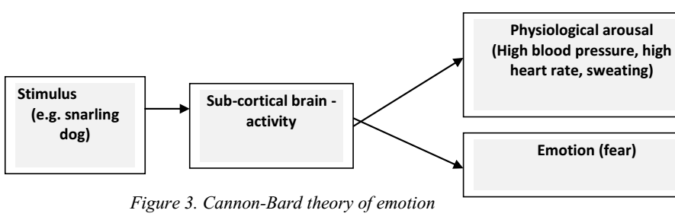
II. Cannon-Bard theory of emotion
  theorized that the emotion and the physiological arousal occur more or less at the same time.
  an emotion - arousing stimulus simultaneously triggers (1) physiological responses and (2) the subjective experience of emotion..

Slide 17

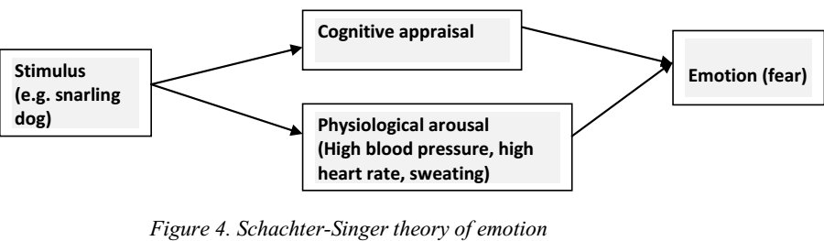
III. Schechter-Singer & Cognitive Arousal theory
  Schachter-Singer (1962) proposed that two things have to happen before emotion occurs: the physical arousal and labeling of the arousal based on cues from the surrounding environment.

Slide 18
Few basic emotions
joy, fear, anger, disgust, sadness, surprise, acceptance and anticipation
complex emotions (e.g. anxiety, worry, curiosity) arise from mixtures of these basic ones
Universal basic emotions
include: happiness, sadness, fear, anger, surprise, and disgust
September, 2008
E. W/G

Slide 19
THE END
THANK YOU VERY MUCH
E. W/G
September, 2008

